Slide 1

Packages Unit 5

Slide 2
Objectives
Packages
Name clashes
Packages
class path and CLASSPATH environmental variables
Importing a package
Default access specifier
JAR files
Lib/ext JAR files

Slide 3



Name clashes
Packages
class Connection {
public void connectToOracle() { }
}
class Connection {
public void connectToSybase() { }
}
class DatabaseWriter{
public static void main(String[ ] args)
{
Connect to Oracle , developed by team X
Connect to Sybase , developed by team Y
Connection connection = new Connection(); connection.connectToOracle();
//Error
}
}
Notes:
if package would not be there the, suppose in one team of a project they have developed a class with name A if some other team developed a class with same name A then there would be conflict for class user(other developer) and can give unexpected user.

Slide 4
Name clashes
Packages
In the earlier example two classes with the same name Connection existed, one to connect to Oracle database and other to Sybase database.
Since the class names were same there is no way to specify which of the two classes to use.
In general, while an application is being developed, several classes are written by different programmers.
Care should also be taken to ensure that ‘re-declarations’ do not happen when these classes are integrated
How would you solve the problem of name clashes?

Slide 5
What is a Package?
Packages
To make types (classes and interfaces) easier to find and use, to avoid naming conflicts, and to control access, programmers bundle groups related types into packages.
A package is a grouping of related classes,
interfaces etc, providing
namespace management.
Uses of Package
access protection and
Organization of related classes in to units.
Reduce Naming conflicts
Protection of variables, methods and classes.
Can contain further subpackages.
A package is both a directory as well as a library

Slide 6


Creating Packages
Packages
To create a package, first choose the name of the package.
package instruments; public interface Instrument
{
……
}
package instruments; public class Sitar implements
Instrument
{
…….
}
public class Violin implements
Instrument
{
……
}
To include a class or
of a
interface to be a part
a package, put
package statement with the name of package at the top of every source file that contains the classes or interface.

Slide 7
Rules for creating Packages
Packages
The package statement must be the first line in the source file.
There can be only one package statement in each source file and it applies to all types in the file.
If there are multiple classes or interface in the same source file, only one can be public, and it must have the same name as the source file.
Only the public type will be accessible from outside of the package, and all the non-public types will be private to the package.

Slide 8

Rules for creating Packages
Packages
package instruments;
public class Violin implements Instrument
{
public void play() { }
}
A physical folder with the same name as the package has to created and all the .class files belonging to that package has to included in it.
Example
On compilation of the above code we would get a Violin.class file, this file should be included in a directory instruments.
C:/myproject/instruments/Violin.class

Slide 9

Nested packages
Packages
package instruments.western; public class Guitar implements
instruments.Instrument
{
public void play() { }
}
A package can be nested inside another package.
Here on
compilation of the above code we would get a
Guitar.class file, this file should be included in a directory instruments/western.
C:/myproject/instruments/western/Guitar.class

Slide 10
Package naming convention
Packages
With
programmers worldwide
writing classes and
interfaces using Java, it is likely that many programmers will use the same name for different types and would lead to name clashes when shared.
This calls for not only the types to be defined in a package to avoid name clashes, but also the package names need to be unique.
Since the Internet domain names are unique for a company, the reversed domain name is used to name a package.
Ex com.pratian.javatraining for a package javatraining
Package names are written in lowercase to avoid conflict with the names of classes or interfaces.
Packages in the Java language itself begin with java.
or javax.

Slide 11
Accessing package members
Packages
The types that comprise a package are
known as the package members.
A public package member can be accessed from outside its package by,
Refer to the member by its fully qualified name
Import the package member
Import the member’s entire package

Slide 12

Accessing package members
Packages
Referring to the member by its fully qualified name
A class or interface belonging a package can be referred by using a fully qualified name.
package com.classical.instruments;
public class Violin implements Instrument
{
public void play() { }
}

Slide 13


Accessing package members
Packages
package com.myorchestra; public class Orchestra
{
public static void main(String [ ] arg)
{
Using the fully qualified name to access Violin class
com.classical.instruments.Violin violin = new
com.classical.instruments.Violin();
violin.play();
}
}

Slide 14


Accessing package members
Packages
Import the package member
To import a specific member into the current file, put an import statement at the beginning of the file before any type definitions but after the package statement, if there is one.
This approach works well if just few m^{Us}e^{in}m^{g}b^{t}e^{he}rs^{im}o^{p}f ºa^{rt}package are used. But to use many types of a tpoaacckcaegsse tahere required then the entire package has to be imporVteiodl.in class
package com.myorchestra;
import com.classical.instruments.Violin; public class Orchestra {
public static void main(String [ ] arg) { Violin violin = new Violin(); violin.play();
}
}

Slide 15


Accessing package members
Packages
Import all the members of a package
To import all the types contained in a particular package, use the import statement with the asterisk(*) wildcard character.
Using the import with *, to access all members of the package
package com.myorchestra;
import com.classical.instruments.*; public class Orchestra {
public static void main(String [ ] arg) { Violin violin = new Violin(); violin.play();
}
}

Slide 16

classpath
Packages
package com.pratian.mypackage;
public class MyClass
{
………………
}
When the above source file is compiled, the compiler generates a MyClass.class file, this file can be located at,
<path to parent directory of the output file> com\pratian\mypackage\MyClass.class
Here the .class file should be in a series of directories that reflect the package name.

Slide 17
classpath
Packages
Now, when the package com.pratian.mypackage is imported in a source file, the JVM needs the full path to the com folder to include the classes in the package. This full path to the com folder is must be included in the CLASSPATH environment variable.
For example, if
C:\JavaApplication\classes com.pratian.mypackage
is in the classpath,
is the package name,
then the compiler will look for the MyClass.class in, C:\JavaApplication\classes\com\pratian\mypackage

Slide 18
Setting CLASSPATH system variable
Packages
To display the current CLASSPATH variable
on Windows, use the commands
C:\set CLASSPATH
To set the CLASSPATH variable, use the commands
C:\set CLASSPATH=C:\JavaApplication\classes;%classpath%
The CLASSPATH variable, can as well be set in Windows by changing the System Properties, Advanced settings, which will be demonstrated.

Slide 19

Running an application
Packages
Once the class path is set, the application can be run by giving a fully qualified name of the class with the main.
Example
package instruments. classical; public class Orchestra {
public static void main(String [ ] arg) { Violin violin = new Violin();
violin.play();
}
}
To run the above application from the console, say,
java instruments.classical.Orchestra
Notes:
In eclipse java instruments.classical.Orchestra not required it will handle automatically..

Slide 20
Default Access Specifiers
Packages
A class member can be public, private,
protected or of default access.
All members of the class with default access are accessible only by the members of the package and are not exposed outside the package.
Protected members of a class are accessible
by members | of | the | package | and by
subclasses of | the | class | belonging | to other
package.
A class within a package can be public or default access, only public are accessible outside the package.

Slide 21
Packages
Exercise
Write a Printer class in the package
com.pratian.myprinter with the data member boolean : inUse and the following methods,
setInUse(boolean) : to set the status of the printer . getStatus() : returns the status of the printer.
free() : to free the printer after use
print(String) : to print a String on the console
In the myprinter package ensure that an object of the Printer class can be created only by members of the same package, but the same object can be used outside the package as well.
Write a PrinterManager class in the package com.pratian.myprinter with an instance of Printer class as a data member.
The class has a method getPrinter() which returns the printer object to a client if not in use and has a method releasePrinter( ) which in turn calls the method free() on the printer object.
Import the above package in your program and write a client to create an instance of the PrinterManager and in turn get the printer and write on to the screen.

Slide 22


Static Import
Packages
There are
many
situations
package math;
public class MyMath { public static final double
PI = 3.14;
}
which
requires
frequent
access
to static final fields
(constants) and methods from one classes.
Prefixing the name of these classes over and over can result in cluttered code.
The static import statement can be used to import constants and methods that used without prefixing the class name.
static or more
import static math.MyMath.*;
public class Area { PI used double radius; _{class name} public double areaOfCircle() {
return PI * radius * radius ;
}
}
without the
Notes:
Instead of using Classname.finalConstant every where we can directly import that static variable and use that variable directly….

Slide 23
JAR Files
Packages
The Java Archive (JAR) file format enables to bundle
multiple files into a single archive file.
Need for JAR files
Compression – The JAR format allows compression of files for efficient storage.
Decreased download time – If a library is bundled in a JAR file, the resources can be downloaded in a single transaction, without the need for opening a new connection for each file.
Package Sealing - Packages stored in JAR files can be optionally sealed so that the package can enforce version consistency. Sealing a package within a JAR file means that all classes defined in that package must be found in the same JAR file.
Package Versioning - A JAR file can hold data about the files it contains, such as vendor and version information.
Portability - The mechanism for handling JAR files is a standard part of the Java platform's core API.

Slide 24
Creating a JAR File
Packages
The basic format of the command for creating a JAR file is:
jar cvf jar-file input-file(s)
The options and arguments used in this command are:
The c option indicates that you want to create a JAR file.
The f option indicates that you want the output to go to a file rather than to stdout.
jar-file is the name that you want the resulting JAR file to have. By convention, JAR filenames are given a .jar extension, though this is not required.
The input-file(s) argument is a space-separated list of one or more files that you want to include in your JAR file. The input-file(s) argument can contain the wildcard * symbol. If any of the "input- files" are directories, the contents of those directories are added to the JAR archive recursively.
The c and f options can appear in either order, but there must not be any space between them.
This command will generate a compressed JAR file and place it in the current directory.

Slide 25
Viewing contents of a JAR File
Packages
The basic format of the command for viewing the
contents of a JAR file is:
jar tvf jar-file
The options and arguments used in this command are:
The t option indicates that you want to view the table of contents of the JAR file.
The f option indicates that the JAR file whose contents are to be viewed is specified on the command line.
The jar-file argument is the path and name of the JAR file whose contents you want to view.
The t and f options can appear in either order, but there must not be any space between them.
This command will display the JAR file's table of contents to stdout.

Slide 26
Extracting contents of a JAR File
Packages
The basic command to use for extracting the contents of a JAR
file is:
jar xvf jar-file [archived-file(s)]
The options and arguments used in this command are:
The x option indicates that you want to extract files from the JAR archive.
The f options indicates that the JAR file from which files are to be extracted is specified on the command line, rather than through stdin.
The jar-file argument is the filename (or path and filename) of the JAR file from which to extract files.
archived-file(s) is an optional argument consisting of a space- separated list of the files to be extracted from the archive. If this argument is not present, the Jar tool will extract all the files in the archive.
The order in which the x and f options appear in the command doesn't matter, but there must not be a space between them.
When extracting files, the Jar tool makes copies of the desired files and writes them to the current directory, reproducing the directory structure that the files have in the archive. The original JAR file remains unchanged.

Slide 27
Adding a JAR file to class path
Packages
While adding JAR files to the classpath, it is necessary to add, not just the location, but also the file name of the JAR file.
E.g. – Consider a JAR file called MyLib.jar located in
C:\MyJava\Project\MyLib.jar
set classpath=C:\MyJava\Project\MyLib.jar And not
set classpath=C:\MyJava\Project\

Slide 28
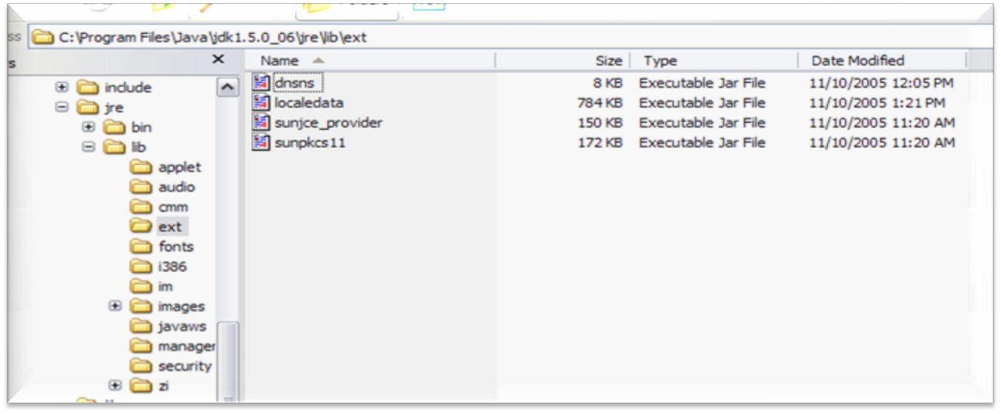
Lib/ext JAR files
Packages
JAR files placed in <jrehome>/lib/ext folder need not be explicitly included in the class path, they are as if automatically in the class path.

Slide 29

Packages
Question time
Please try to limit the questions to the topics discussed during the session. Participants are encouraged to discuss other issues during the breaks.
Thank you.

